Slide 1
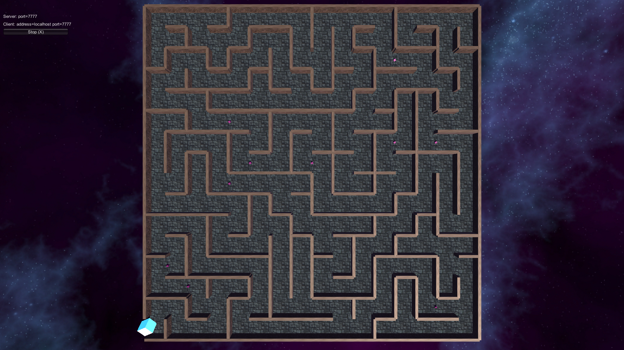
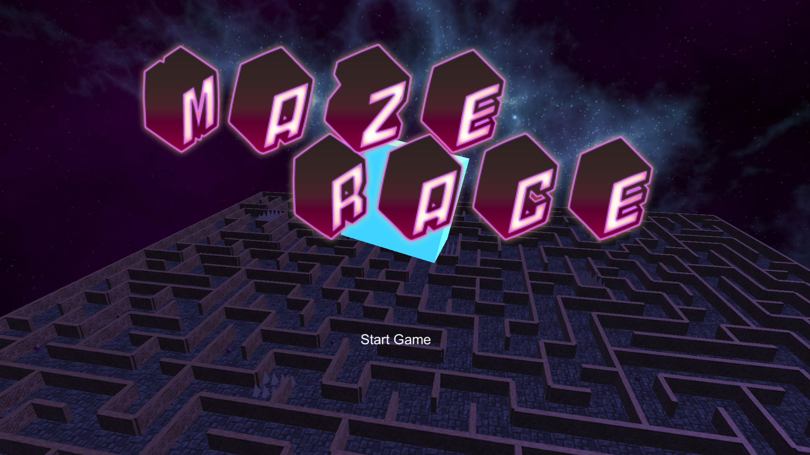
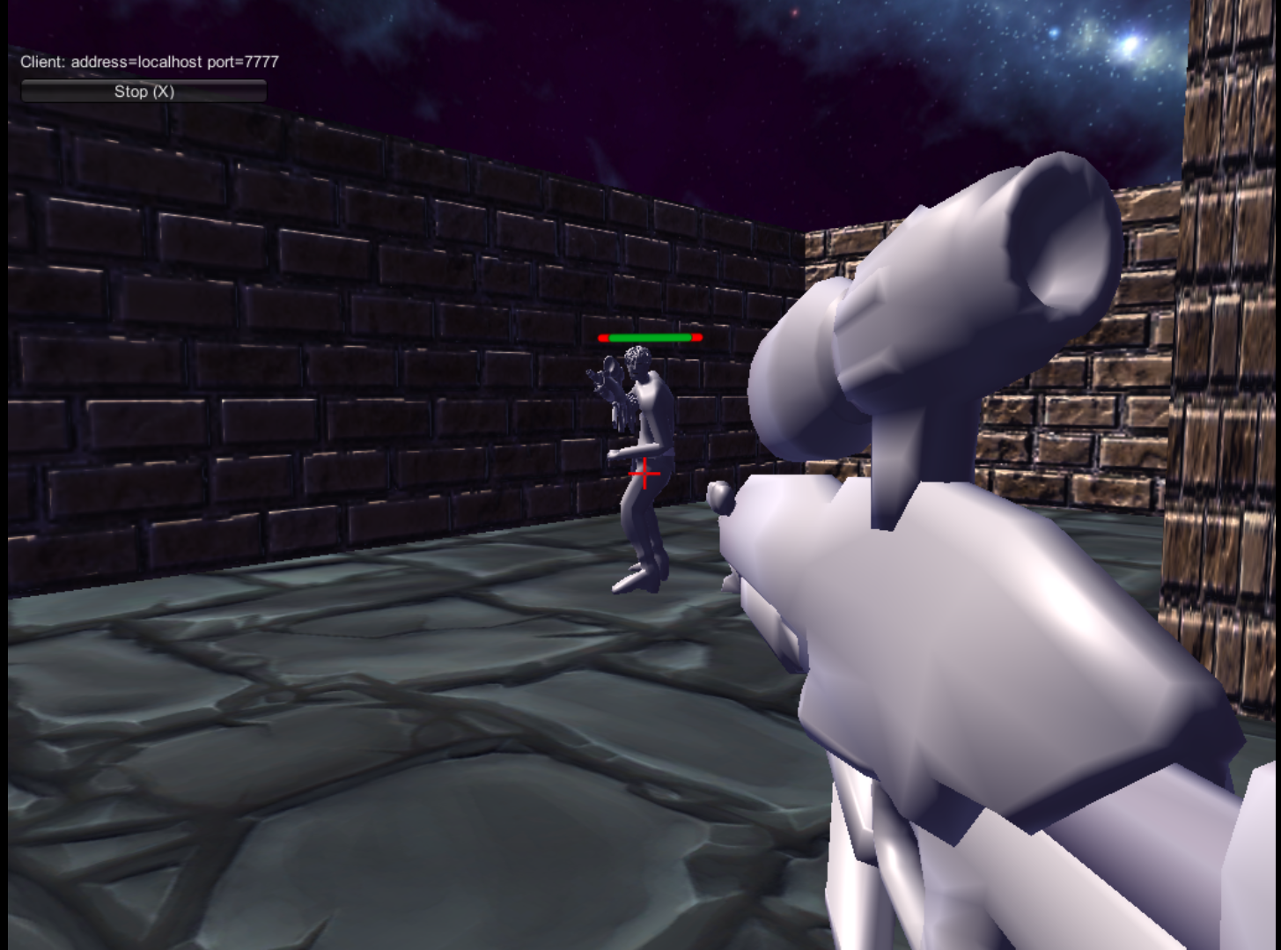
Maze Race – 3D Lan multiplayer FPS
Atte Visuri, Eetu Lehmus, Jani Kärkkäinen, Anni Toivanen
School of Engineering and Natural Recources, Information Technology, Software Engineering
Introduction
The goal of our project was to design a fun innovative multiplayer online experience. We chose to create a solution for displaying a game on a monitor. We were granted use of unity. Our goal was to create both a game for the windows and a fun activity between friends.
FIGURE 1. Intro screen
Unity3D
Unity is a cross-platform game engine developed by Unity Technologies and used to develop video games for PC, consoles, mobile devices and websites. First announced only for OS X, at Apple's Worldwide Developers Conference in 2005, it has since been extended to target 21 platforms. Nintendo provides free licenses of Unity 5 to all licensed Nintendo Developers along with their software development kits (SDKs) for the Wii U and Nintendo 3DS Family.
FIGURE 2. End screen
Methods
Our main goal was to create a randomly generated maze experience with Unity’s existing tools and C# programming language. The game was designed to run quickly without needing a setup. The game featured a multiplayer which was done using Unity’s existing networking components and a help of their tutorials of the subject. The players have to then try to find the exit of the maze, while trying to shoot the other players to kill them until they die. After dying, the players respawn and continue normally.
FIGURE 3 Game screen
Results
The game allows user to decide a size for the maze, which is then randomly generated with the seed. Other user(s) can then connect to the host and play. As of the project’s completion, only LAN-connection is possible. There are also spike traps that cause the players to lose health similarly to being shot. When a player finds the exit, he sees the maze from top view as seen in FIG 2.
Conclusions
We filled the project’s requirements succesfully, even though the time was very limited and we didn’t have any proper experience of unity before the project.
References
http://unity3d.com
Project
Date of publication: 2016, Fall
Supervisor Pertti Heikkilä

